Slide 1
COMPILER
Neena Thomas
S3 MCA

Slide 2
Outlines
Introduction
What is compiler?
Parts of compiler
Structure of compiler
Phases of compiler
Conclusion

Slide 3
INTRODUCTION
A compiler is a computer program (or set of programs) that transforms source code written in a programming language (the source language) into another computer language (the target language, often having a binary form known as object code).

Slide 4
What is Compilers Do ?
A compiler acts as a translator,
transforming human-oriented programming languages
into computer-oriented machine languages.
  Ignore machine-dependent details for programmer
Programming
Language
(Source)
Machine
Language
(Target)
Compiler

Slide 5
PARTS OF COMPILER
A compiler consists of two main parts:
The frontend,
and the backend.

Slide 6
THE FRONTEND
The frontend checks whether the program is correctly written in terms of the programming language syntax and semantics.
Here legal and illegal programs are recognized. Errors are reported, if any, in a useful way. Type checking is also performed by collecting type information.
The frontend then generates an intermediate representation or IR of the source code for processing by the back end.

Slide 7
THE BACKEND
The backend is responsible for translating the IR from the front end into assembly code.
The target instruction(s) are chosen for each IR instruction.
Variables are also selected for the registers

Slide 8
The Structure of a Compiler (1)
Any compiler must perform two major tasks
  Analysis of the source program
  Synthesis of a machine-language program
Compiler
Analysis
Synthesis

Slide 9
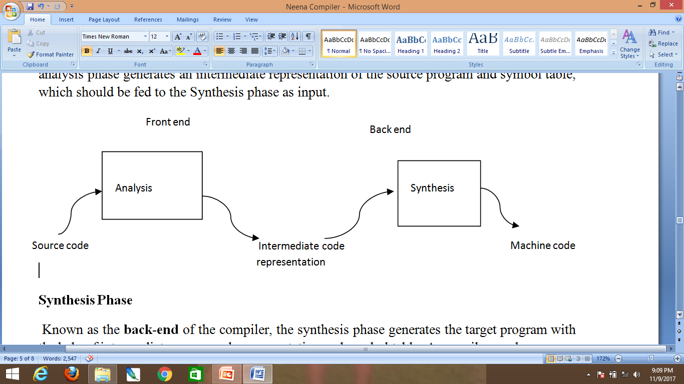


Slide 10
PHASAES OF COMPILER
Lexical analysis
Syntax analysis
Semantic analysis
Intermediate code generation
Code optimization
Code generation
Symbol table
Error detection and correction

Slide 11
LEXICAL ANALYSIS
The first phase of scanner works as a text scanner.
This phase scans the source code as a stream of characters and converts it into meaningful lexemes. Lexical analyzer represents these lexemes in the form of tokens as:
<token-name, attribute-value>

Slide 12
SYNTAX ANALYSIS
The next phase is called the syntax analysis or parsing.
It takes the token produced by lexical analysis as input and generates a parse tree (or syntax tree).
In this phase, token arrangements are checked against the source code grammar, i.e., the parser checks if the expression made by the tokens is syntactically correct.

Slide 13
SEMANTIC ANALYSIS
Semantic analysis checks whether the parse tree constructed follows the rules of language.
For example, assignment of values is between compatible data types, and adding string to an integer.
Also, the semantic analyzer keeps track of identifiers, their types and expressions; whether identifiers are declared before use or not, etc.
The semantic analyzer produces an annotated syntax tree as an output.

Slide 14
INTERMEDIATE CODE GENERATION
After semantic analysis, the compiler generates an intermediate code of the source code for the target machine.
It represents a program for some abstract machine. It is in between the high-level language and the machine language.
This intermediate code should be generated in such a way that it makes it easier to be translated into the target machine code.

Slide 15
CODE OPTIMIZATION
The next phase does code optimization of the intermediate code.
Optimization can be assumed as something that removes unnecessary code lines, and arranges the sequence of statements in order to speed up the program execution without wasting resources (CPU, memory).

Slide 16
CODE GENERATION
In this phase, the code generator takes the optimized representation of the intermediate code and maps it to the target machine language.
The code generator translates the intermediate code into a sequence of (generally) re-locatable machine code.
Sequence of instructions of machine code performs the task as the intermediate code would do.

Slide 17
SYMBOL TABLE
It is a data-structure maintained throughout all the phases of a compiler.
All the identifiers’ names along with their types are stored here.
The symbol table makes it easier for the compiler to quickly search the identifier record and retrieve it. The symbol table is also used for scope management.

Slide 18
Error detection and correction
Detection of Errors.
To be useful, a compiler should detect all errors in the source code and report them to the user. These errors could be:
Lexical error
Syntactic error
Semantic error
Runtime error

Slide 19
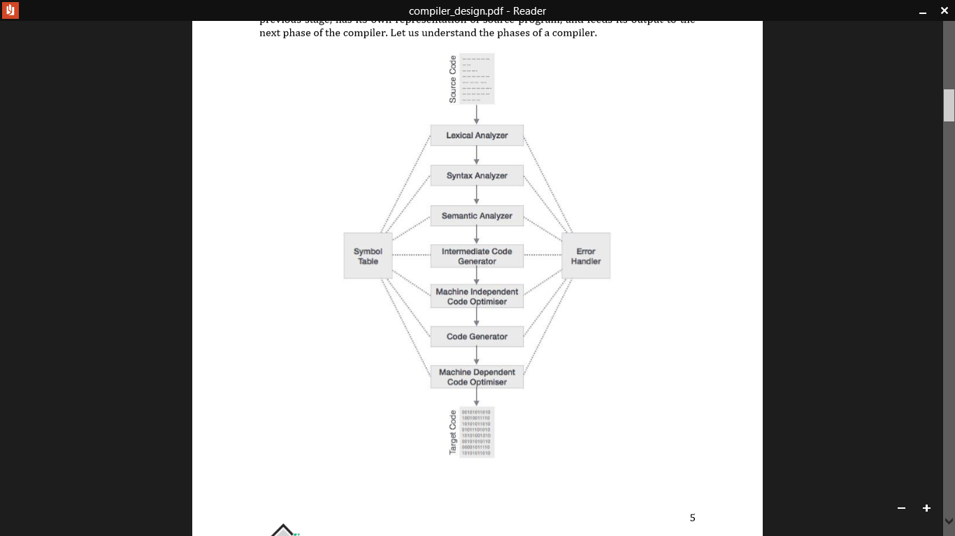

Slide 20
CONCLUSION
Compiler technology is useful for a more general class of applications.
Many programs share the basic properties of compilers: they read textual input, organize it into a hierarchical structure and then process the structure

Slide 21
Thank you…….

